Slide 1
MMA 867 Predictive Modeling Introduction
Jue Wang

Slide 2
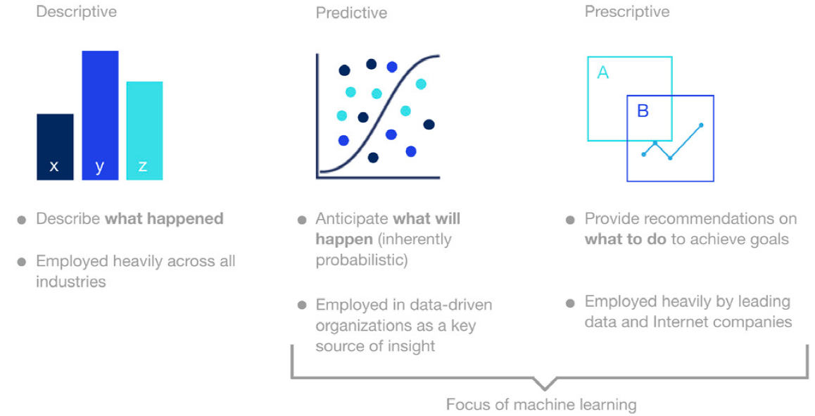
Analytics: Descriptive versus Predictive versus Prescriptive

Slide 3
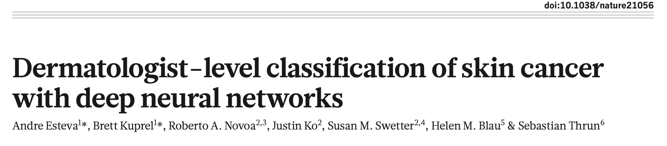
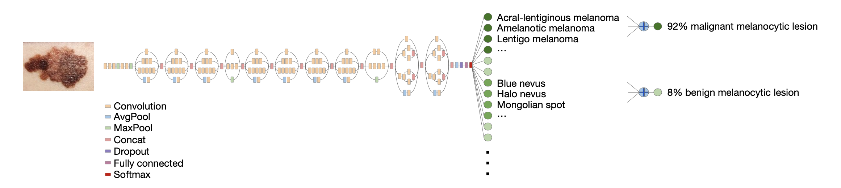
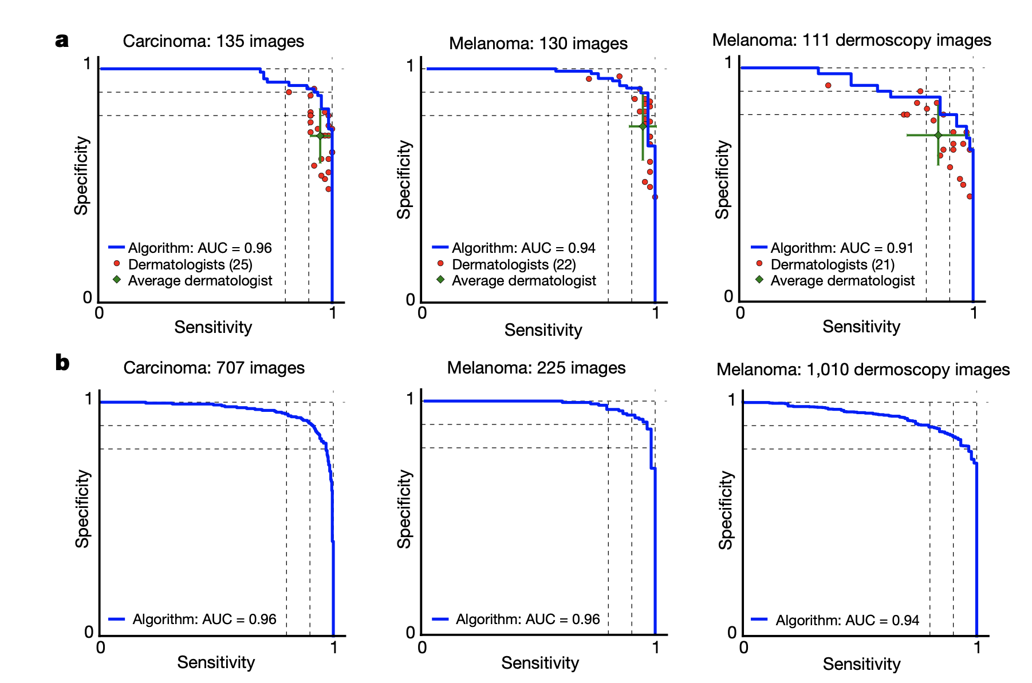

Slide 4
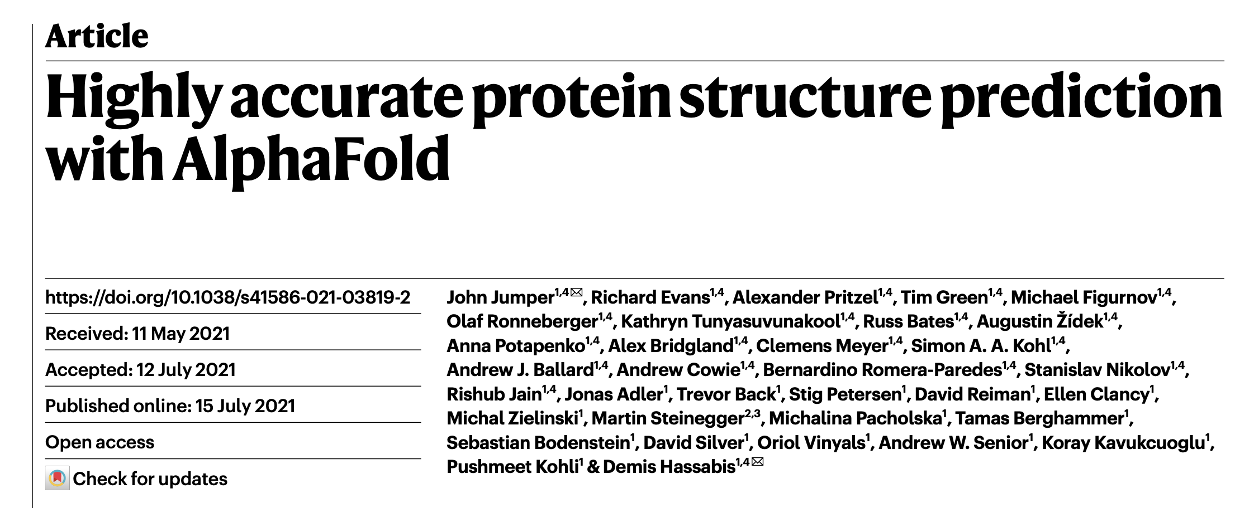
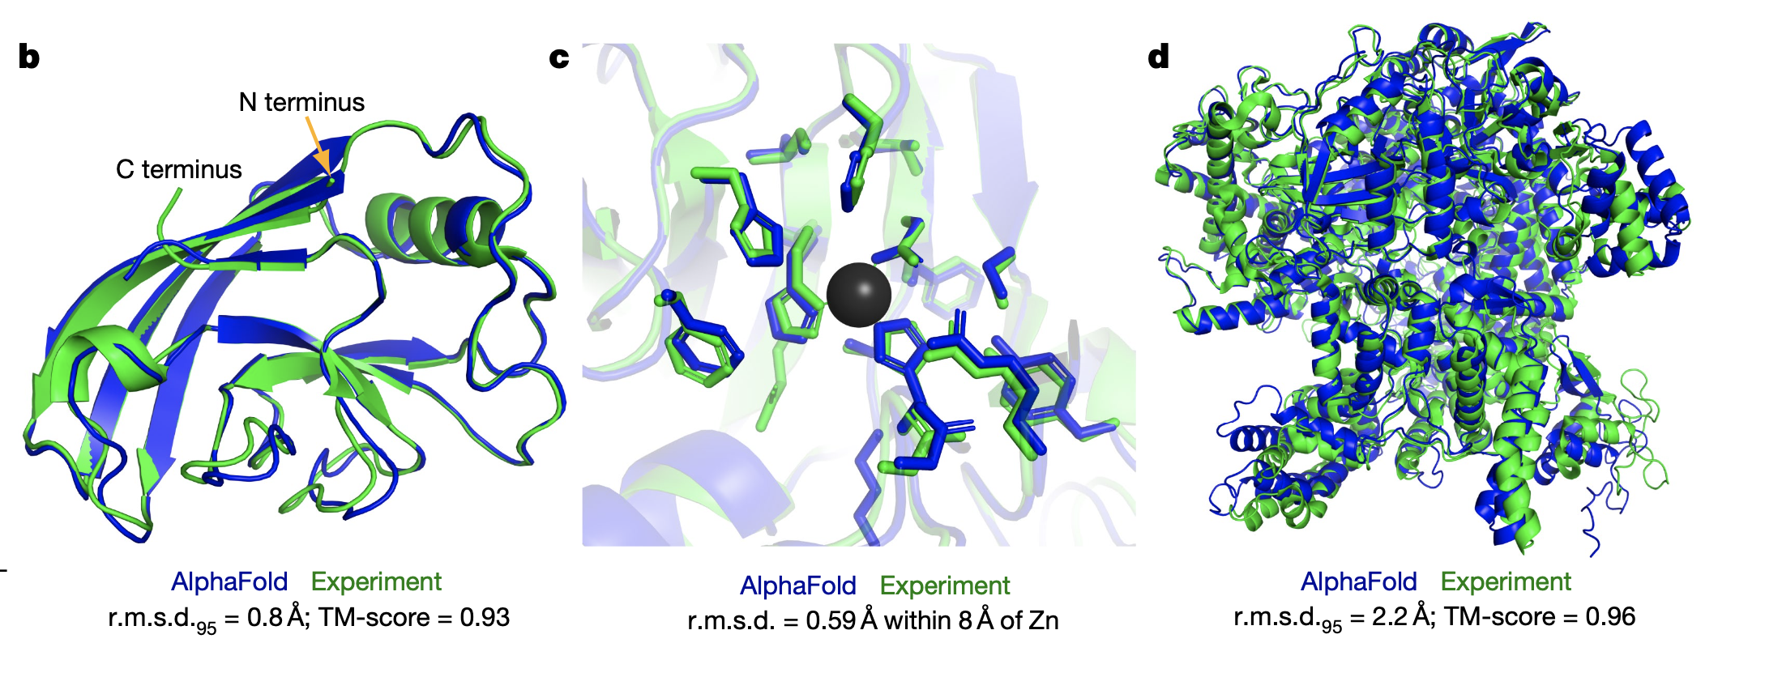

Slide 5
ChatGPT
Large Language Model (LLMs)
By Molly Ruby

Slide 6
Alpha-Go & Wildlife Survey
Milda et.al. (2020)
Sequential decisions over space
Wildlife survey suffers from imperfect detections

Slide 7
Reinforcement Learning
Offline training
Online play (often involves predictive modelling)

Slide 8
Wang et. al. (2023)

Slide 9
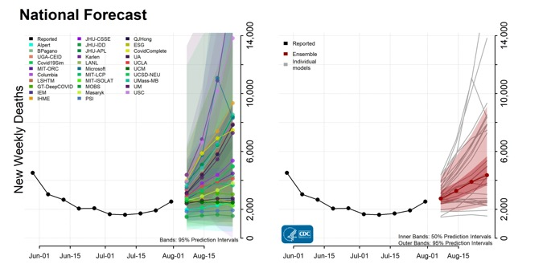
Predictions of COVID-19 Dynamics in the US
Why do we need predictive models?

Slide 10

Youyang Gu Model
An 27-year old MIT grad with a master’s degree in EECS, working on a sports analytics startup.
Gu's model "is the most accurate to predict deaths from COVID-19", surpassing the accuracy of many well-funded models from prestigious organizations.
“I had zero background in infectious-disease modeling… It turns out that a lot of infectious-disease modeling is basically statistical modeling”
-Youyang Gu
Learn more at https://covid19-projections.com/

Slide 11
Youyang Gu Model: “SEIR + Machine Learning”
“My models have shown the importance of simplicity, which is often undervalued.”
“There is this belief that if you add more data to the model, or make it more sophisticated, then the model will do better.”
“But My goal was to just follow the data on covid to learn about covid. My model only uses past deaths to predict future deaths. It doesn’t use any other real data source.”
-Youyang Gu
https://www.technologyreview.com/2021/04/27/1023657/lessons-from-the-pandemics-superstar-data-scientist-youyang-gu/

Slide 12
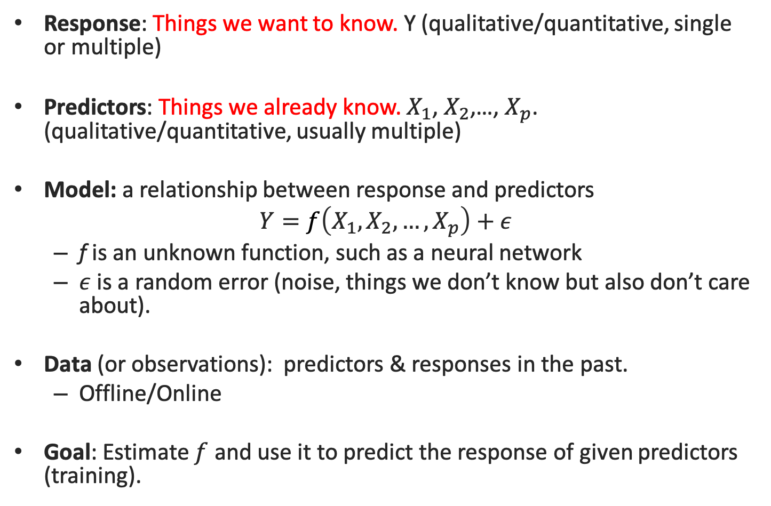
Predictive Model
Response: Things we want to know. Y (qualitative/quantitative, single or multiple)
Predictors: Things we already know. $X_{1}$, $X_{2}$,…, $X_{p}$. (qualitative/quantitative, usually multiple)
Model: a relationship between response and predictors
$$Y=f\left(X_{1},X_{2},…,X_{p}\right)+ε$$
f is an unknown function, such as a neural network
$ε$ is a random error (noise, things we don’t know but also don’t care about).
Data (or observations): predictors & responses in the past.
Offline/Online
Goal: Estimate $f$ and use it to predict the response of given predictors (training).

Slide 13
Simple Linear Regression
Multiple Linear Regression
(one response, one predictor)
(one response, multiple predictors)
(May include both qualitative and quantitative predictors)

Slide 14
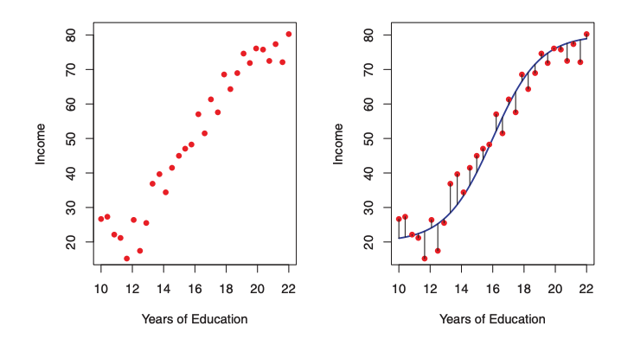
Predictive Model

Slide 15
Some Statistical Predictive Models
Predictor Response | Categorical | Continuous
Continuous | ANOVA (Analysis of Variance) | Simple or Multiple Regression
Categorical or Ordinal | Generalized Linear Models (e.g. Logistic Regression)

Slide 16
Course Administration
Syllabus
Assignments: 1 Team assignment + 1 Individual assignment
Final project: team
Contacting me: juewang-faculty@queensu.ca
(Note that jue.wang@queensu.ca is NOT my email)
Office hours: After class

Slide 17
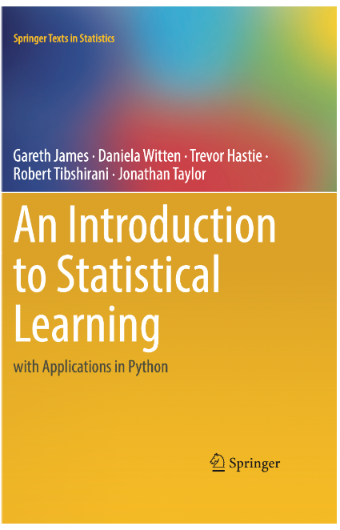
E-Textbook: James et. al. (Python version)
https://hastie.su.domains/ISLP/ISLP_website.pdf.download.html

Slide 18
Learning Objectives of Regression (Session 1)
Module 1: Assessing model accuracy (Chapter 2.2 of James et. al.)
Module 2: Data transformations (Chapter 3.3.2)

Slide 19
Learning Objectives of Regression (Session 2)
Module 3: Qualitative predictors (Chapter 3.3.1), Interactions (Chapter 3.3.2)
Module 4: Shrinkage Methods for regularization (Chapter 6.2)
Assignment #1: Kaggle competition (Team)

Slide 20
Module 1: Model Selection & Assessment

Slide 21
Model Selection: Which Model is Better?
Suppose you have fitted two different models to the entire dataset and found that
Model A has an R-squared 0.89
Model B has an R-squared 0.67
Which model will you choose as the final model (i.e., for the prediction of new samples)?

Slide 22
Model selection: estimating the performance of different models in order to choose the best one.
A training set is used to estimate the parameters of the model.
A testing set is used for assessing the prediction performance of the model.
kept in a “vault”, brought out only at the end
(75%)
(25%)
Historical data

Slide 23
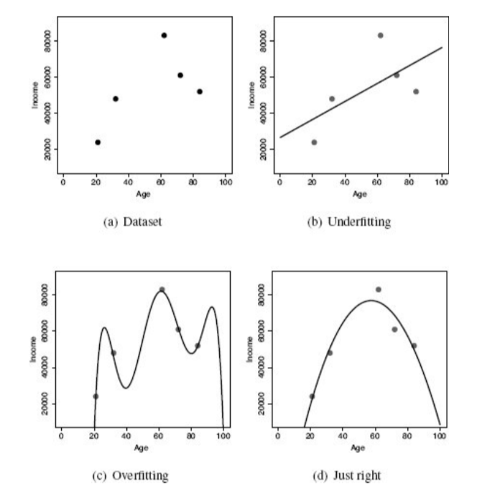
Model Selection
To choose the best model, we don’t want to fit the training set “too well”.
Rather, we want to fit the training set “just right”.
training set

Slide 24
Use the training set to fit the model and then apply this model to the testing set to evaluate the model performance.
Select the model that performs the best in the testing set.
Never include the testing set when fitting a model and then apply that model back to the testing set (Why?)
The “75/25” split is just a rule of thumb. What happens if you change it to “70/30”?
How do we create the training/testing sets?
Cross-sectional data
Time series data
We can even create multiple testing sets.

Slide 25
Model Assessment: Training/Validation/Testing
In some cases (e.g., Kaggle competition), some samples are not released to the public. These private data are the “testing set” that the data provider uses to assess the ultimate prediction performance of a model.
As a competition participant, you can split the public data further into 75% training and 25% testing. But the 25% testing set is now called the “Validation set”.
Training (75%)
Validation (25%)
Testing
Public data
Private data

Slide 26
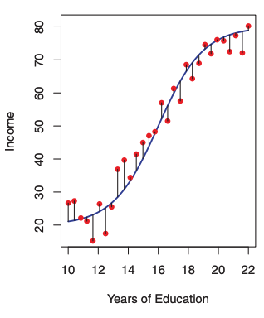
Mean Squared Error (MSE)
In-sample error (Residuals, fitting error): error in training set
Out-of-sample error (prediction error): error in testing set

Slide 27
Bias and Variance

Slide 28
Bias and Variance Trade-off
Total error
Bias
Variance
Model Complexity
Simple model has more bias but less variance
Complex model has less bias but more variance

Slide 29
Module 2: Data Transformation

Slide 30
Key assumptions of linear regression
Linearity
Normal errors
Homoscedasticity

Slide 31
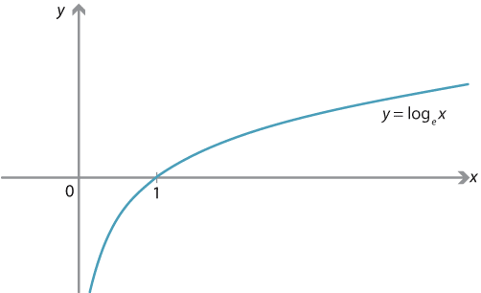
Log transform
When the key assumptions are violated, we can use data transformation to preprocess the data.
Log transform is an effective method to “normalize” the response variable and stabilize its variance.

Slide 32
Python Example:
Open the code “ClassDemo Session 1-2”

Slide 33
Data Transformation
Log (Y) or Log (X)?

Slide 34
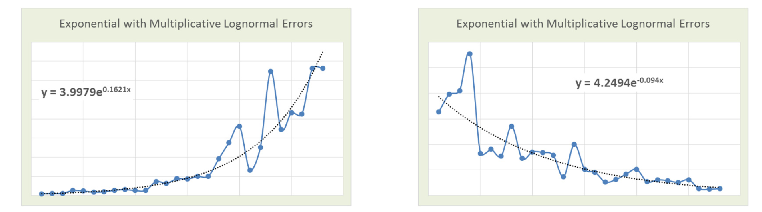
Nonlinear Models
If the residual plot suggests nonlinearity, we can also use log transform to “linearize” the data.
Example: Exponential Models

Slide 35
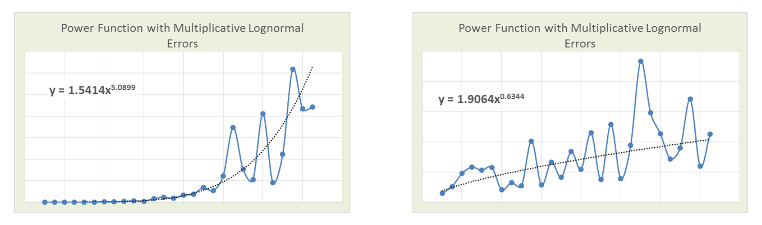
Nonlinear Models
Another example: Power Models

Slide 36
Intrinsically Nonlinear Models
Transformation is a powerful technique. However, some complicated relationships cannot be transformed to linear models with simple transformations.
For example, we cannot linearize the model
Such models are “intrinsically nonlinear”. Fortunately, the parameters can be usually be estimated with nonlinear regression methods.

Slide 37
Group Discussion #1

Slide 38
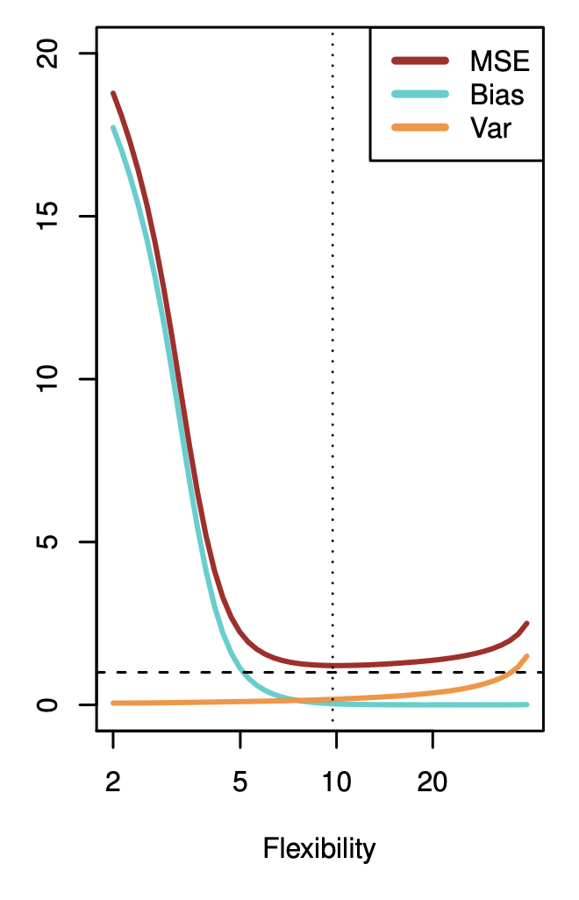
Conceptual Questions
We have samples from 2000 to 2021.
We use samples from 2010 to 2021 to fit a model. The squared error in 2020 is 1.75. Is this an out-of-sample error?
We use samples from 2005 to 2021 to fit a model. The squared error in 2001 is 2.35, is this an in-sample error?
In predictive modeling, we should choose the model that minimizes
both in-sample error and out-of-sample error
in-sample error
out-of-sample error
The “U”-shape MSE curve on the right figure is
An in-sample error
An out-of-sample error
Sum of in-sample error and out-of-sample error

Slide 39
For each of parts (a) through (d), indicate whether we would generally expect the performance of a flexible statistical learning method to be better or worse than an inflexible method. Justify your answer.
(a) The sample size n is extremely large, and the number of predictors p is small.
(b) The number of predictors p is extremely large, and the number of observations n is small.
(c) The relationship between the predictors and response is highly non-linear.
(d) The variance of the error terms is extremely high.

Slide 40
Python Session:
Open the “Group Session 1-2” code.
Discuss all questions posted

